Slide 1


Aditya University
FRESHMAN ENGINEERING DEPARTMENT
Extend a Hearty Welcome to
Programming
for
Problem Solving Using C
V. Prasaswi
Assistant Professor,
Freshmen Engineering Department

Slide 2
Syllabus
UNIT – I
Introduction to Programming and Problem Solving
Introduction to Programming Languages, Basics of a Computer Program- Algorithms, Algorithmic approach, characteristics of algorithm, Problem solving strategies: Top-down approach, Bottom-up approach, Time and space complexities of algorithms.
flowcharts (Using Dia Tool), pseudo code.
Structure of C Program Introduction to Compilation and Execution, Primitive Data Types, Variables, and Constants, Basic Input and Output, operators, keywords, identifiers, Type Conversion, and Casting.
UNIT – II
Control Structures
Simple sequential programs Conditional Statements (if, if-else, else if ladder, switch), Loops (for, nested for loop , while, do-while) break and continue , goto statement

Slide 3
Syllabus
UNIT – III
Arrays indexing, Accessing programs with array of integers, two dimensional arrays, Introduction to Strings, string handling functions.
Sorting techniques: bubble sort, selection sort.
Searching Techniques: linear , Binary search.
UNIT – IV
Functions: Introduction to Functions, Function Declaration and Definition, Function call Return Types and Arguments, arrays as parameters, Scope and Lifetime of Variables, storage class, recursion, functions & pointers, function, and arrays.
UNIT – V
Introduction to Pointers, dereferencing and address operators, pointer and address arithmetic, array manipulation using pointers, modifying parameters inside functions using pointers, Command line Arguments, Dynamic memory allocation, Null Pointer, generic pointer, dangling pointer
Introduction to Structures Accessing the structure

Slide 4
Books & Web Links
Text Books:
Programming in C, Rema Theraja, Oxford, 2nd edition
The C Programming Language", Brian W. Kernighan and Dennis M. Ritchie, Prentice-Hall.
Reference Books:
Computing fundamentals and C Programming, Balagurusamy, E., McGraw-Hill Education.
Byron Gottfried, Schaum's Outline of Programming with C, McGraw-Hill.
Let Us C Yashwanth,Kanetkar, Eighth edition, BPB Publications
Web Links:
https://www.hackerrank.com/
https://www.codechef.com/
https://onlinecourses.nptel.ac.in/noc22_cs40/preview
https://code-cracker.github.io/

Slide 5
Importance of Course
C programming is a powerful and versatile programming language that plays a significant role in software development.
With its simplicity, efficiency, and wide range of applications, C has stood the test of time and continues to be a popular choice among programmers worldwide.
The importance of C programming cannot be overstated in the world of computer science and programming.
As one of the oldest and most widely used programming languages, C has become the foundation for many modern programming languages.
In short, C programming holds immense importance for anyone interested in the world of coding and software development.

Slide 6
Course Outcomes
At the end of the Course, Student will be able to:
CO1: Demonstrate basics of computer, algorithm and flow chart for problem
solving.
CO2: Make use of an appropriate control structures to solve a given problems.
CO3: Solve complex problems using arrays and strings.
CO4: Develop modular programming using functions and dynamics memory
allocations using pointers.
CO5: Utilize structure, union and file operations to handle heterogeneous
data.

Slide 7
Unit I
UNIT – I
Introduction to Programming and Problem Solving
Introduction to Programming Languages, Basics of a Computer Program- Algorithms, Algorithmic approach, characteristics of algorithm, Problem solving strategies: Top-down approach, Bottom-up approach, Time and space complexities of algorithms flowcharts (Using Dia Tool), pseudo code.
Structure of C Program Introduction to Compilation and Execution, Primitive Data Types, Variables, and Constants, Basic Input and Output, operators, keywords, identifiers, Type Conversion, and Casting.

Slide 8
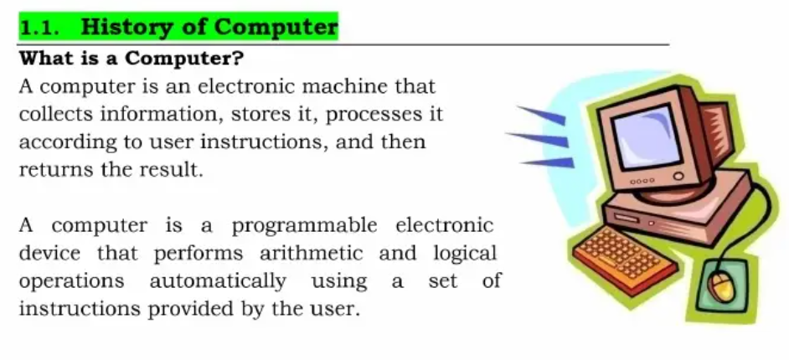

Slide 9
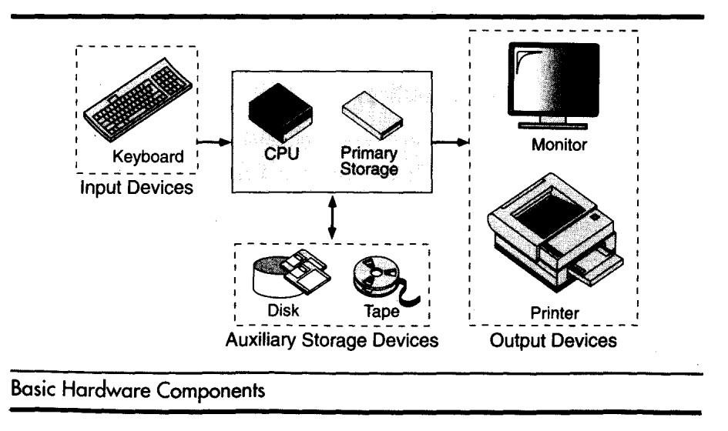
Components of Computer System
A computer is a system made of two major components: hardware and software.
The computer hardware is the physical equipment.
The software is the collection of programs (instructions) that allow the hardware to do its job

Slide 10
Computer Hardware :- The hardware component of the computer system consists of five parts: input devices, central processing unit (CPU) ,primary storage, output devices, and auxiliary storage devices.
The input device is usually a keyboard where programs and data are entered into the computers. Examples of other input devices include a mouse, a pen or stylus, a touch screen, or an audio input unit.
The central processing unit (CPU) is responsible for executing instructions such as arithmetic calculations, comparisons among data, and movement of data inside the system.
The output device is usually a monitor or a printer to show output. If the output is shown on the monitor, we say we have a soft copy. If it is printed on the printer, we say we have a hard copy.
Auxiliary storage, also known as secondary storage, is used for both input and output. It is the place where the programs and data are stored permanently. When we turn off the computer, or programs and data remain in the secondary storage, ready for the next time we need them.

Slide 11
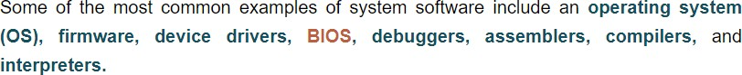
Computer Software :-
Computer software is divided in to two broad categories: system software and application software.
System software manages the computer resources .It provides the interface between the hardware and the users.
Application software, on the other hand is directly responsible for helping users solve their problems.

Slide 12
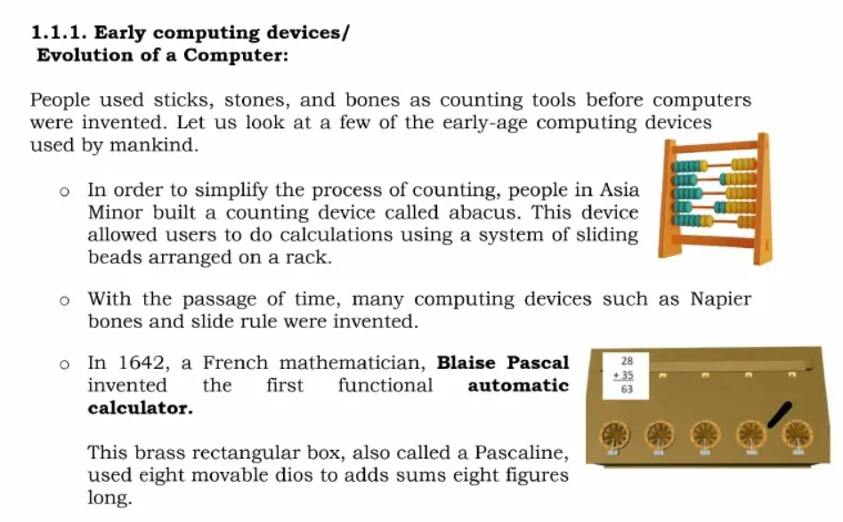

Slide 13
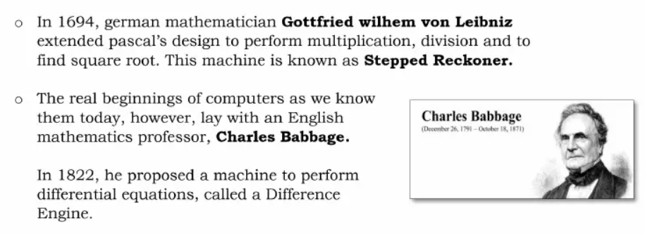

Slide 14
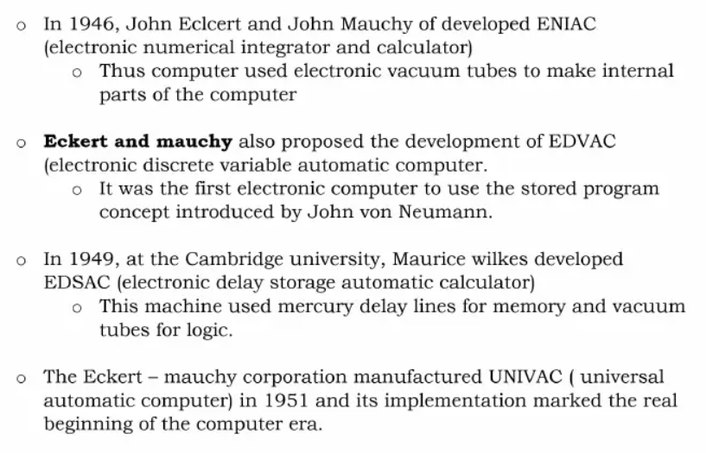

Slide 15
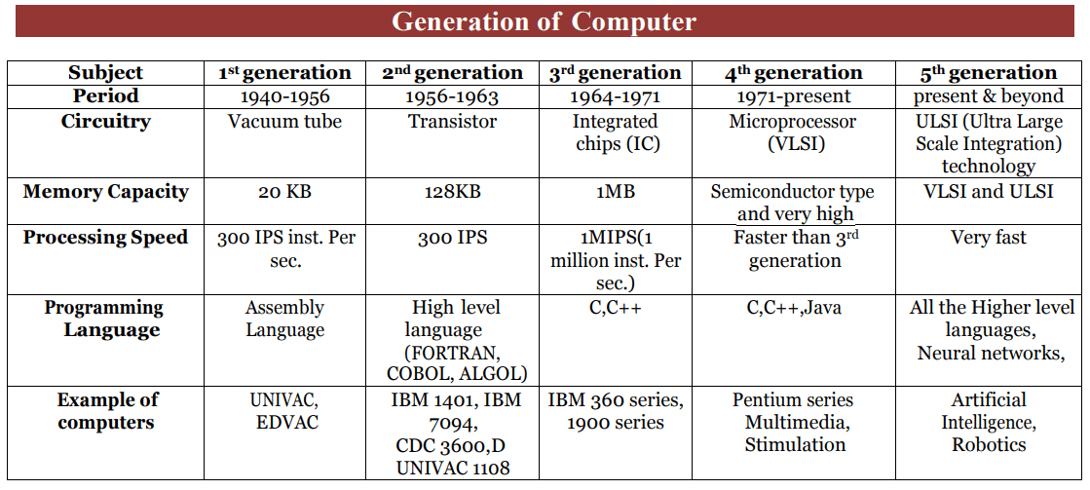

Slide 16
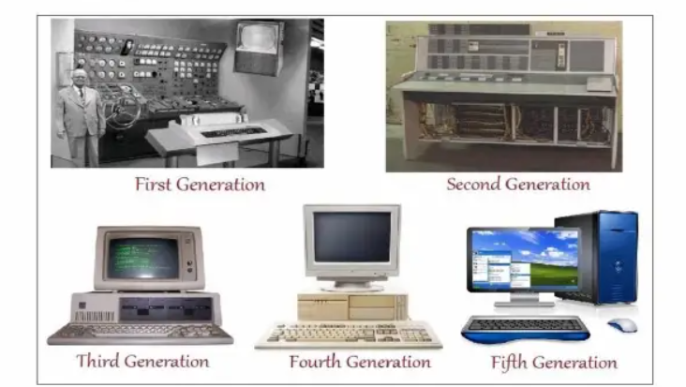

Slide 17
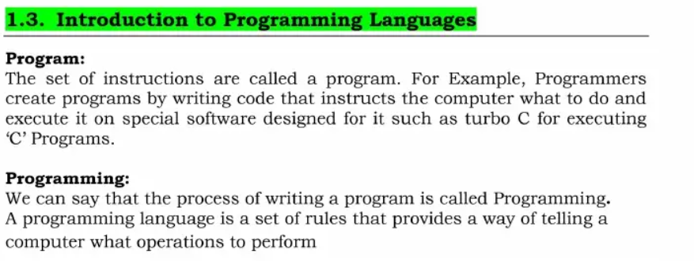

Slide 18
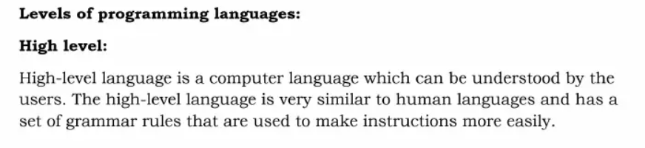
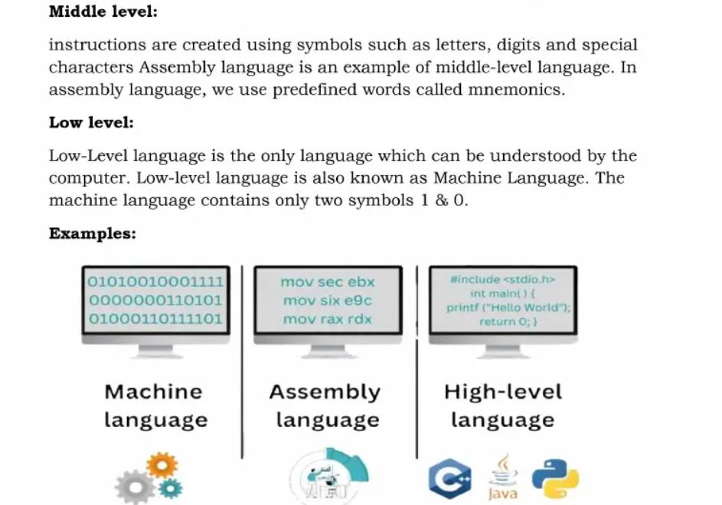

Slide 19
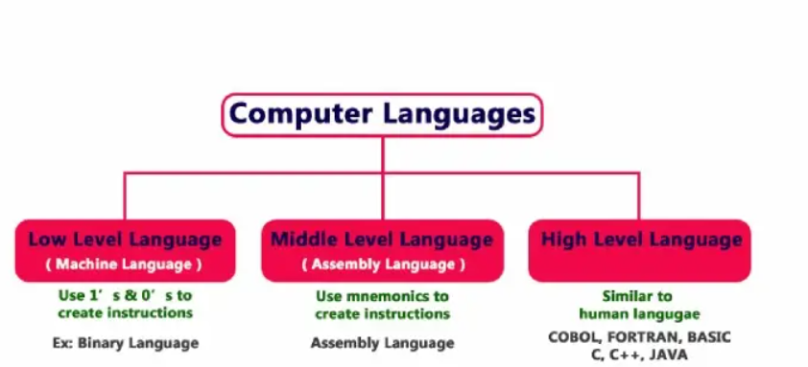

Slide 20
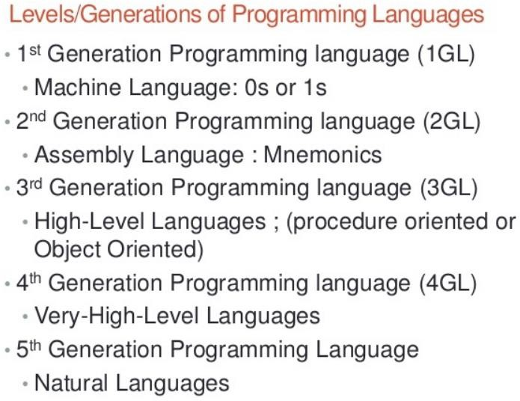

Slide 21
C language
C is a general-purpose, high-level language that was originally developed by Dennis M. Ritchie at AT & TBell Labs in 1972.
C is a procedural programming language
C was invented to write an operating system called UNIX

Slide 22
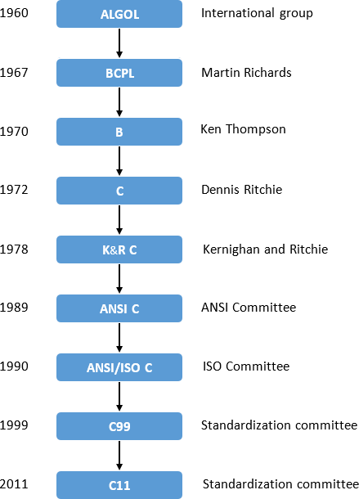
History of C

Slide 23
Computer Languages
To write a program for a computer, we must use a computer language. Over the years computer languages have evolved from machine languages to natural languages.
1940’s Machine level Languages
1950’s Symbolic Languages
1960’s High-Level Languages
Machine Languages:
In the earliest days of computers, the only programming languages available were machine languages. Each computer has its own machine language, which is made of streams of 0’s and 1’s.
Instructions in machine language must be in streams of 0’s and 1’s because the internal circuits of a computer are made of switches transistors and other electronic devices that can be in one of two states: off or on. The off state is represented by 0 , the on state is represented by 1.
The only language understood by computer hardware is machine language

Slide 24
Computer Languages
Symbolic Languages:-
In early 1950’s Admiral Grace Hopper, A mathematician and naval officer developed the concept of a special computer program that would convert programs into machine language.
Computer does not understand symbolic language it must be translated to the machine language. A special program called assembler translates symbolic code into machine language.

Slide 25
Computer Languages
High Level Languages:-
Symbolic languages greatly improved programming efficiency;
still required programmers to concentrate on the hardware that they were using.
Working with symbolic languages was also very tedious because each
machine instruction has to be individually coded. The desire to improve programmer efficiency and to change the focus from the computer to
the problem being solved led to the development of high-level language.

Slide 26
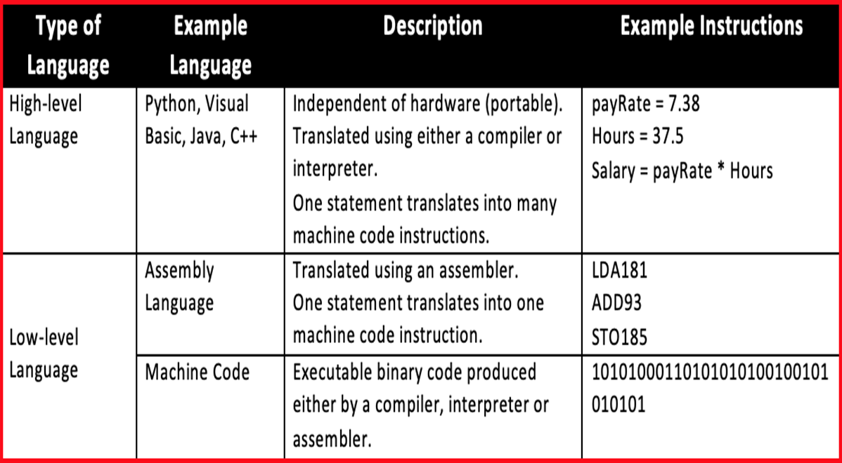
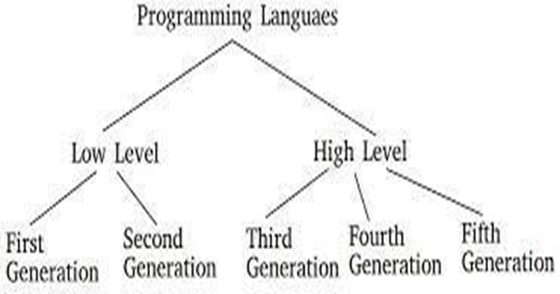
Computer Programming Languages

Slide 27

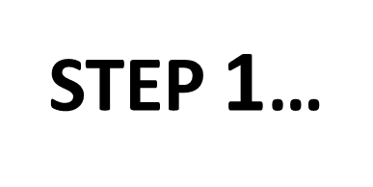
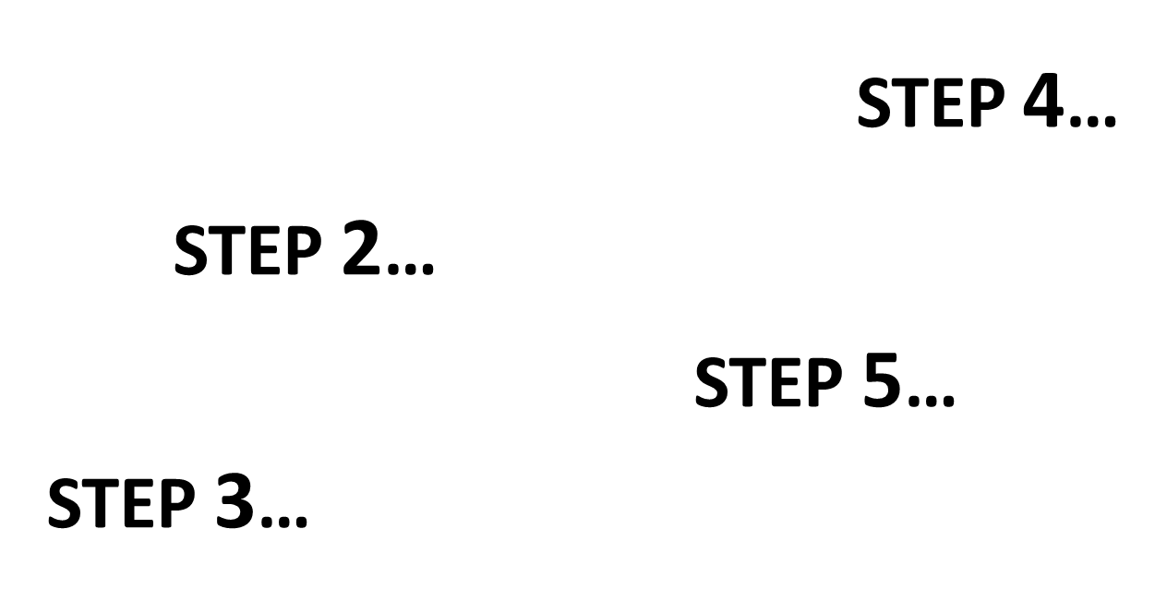
ALGORITHMS

Slide 28
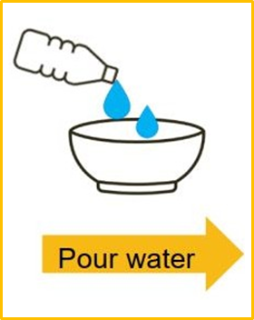
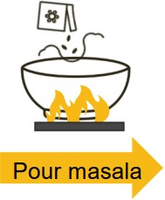
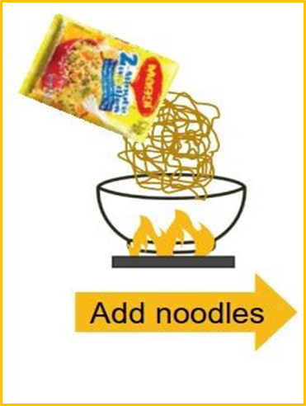
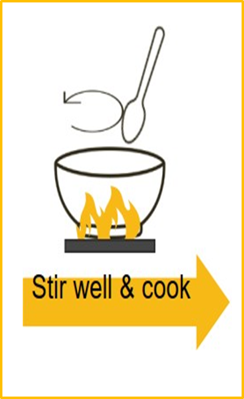
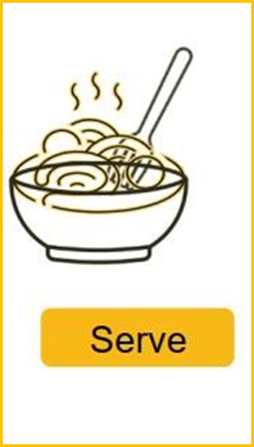
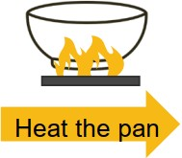
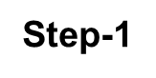
Real Life example for algorithm
How do you make Maggi?
Step-2
Step-3
Step-4
Step-5
Step-6

Slide 29
Algorithm
Algorithm is a step by step procedure for solving a problem.
Example: Algorithm for find square root of a given number?
Step 1: Start
Step 2: Read a number x
Step 3: Find square root of given number x
Step 4: print the square root value
Step 5: Stop

Slide 30
Algorithm
Example: Algorithm for checking whether the given number is positive or negative?
Step 1: Start
Step 2: Read a number x
Step 3: if x is greater than or equal to zero, print x is positive
Step 4: if x is less than zero, print x is negative
Step 5: Stop

Slide 31
Characteristics of algorithm
Input : An algorithm has zero or more inputs, i.e, quantities which are given to it initially before the algorithm begins.
Output: An algorithm has one or more outputs i.e, quantities which have a specified relation to the inputs.
Finiteness: An algorithm must always terminate after a finite number of steps.
Definiteness: Each step of an algorithm must be precisely defined; the actions to be carried out must be unambiguously specified for each case.
Effectiveness: An algorithm is also generally expected to be effective. This
means that all of the operations to be performed in the algorithm must be
sufficiently basic that they can in principle be done exactly and in a finite length of time.

Slide 32
Flow chart
A Flow chart is a Graphical representation of an Algorithm or a portion of an Algorithm.
The diagrammatic representation of way to solve the given problem is called flow
chart.

Slide 33
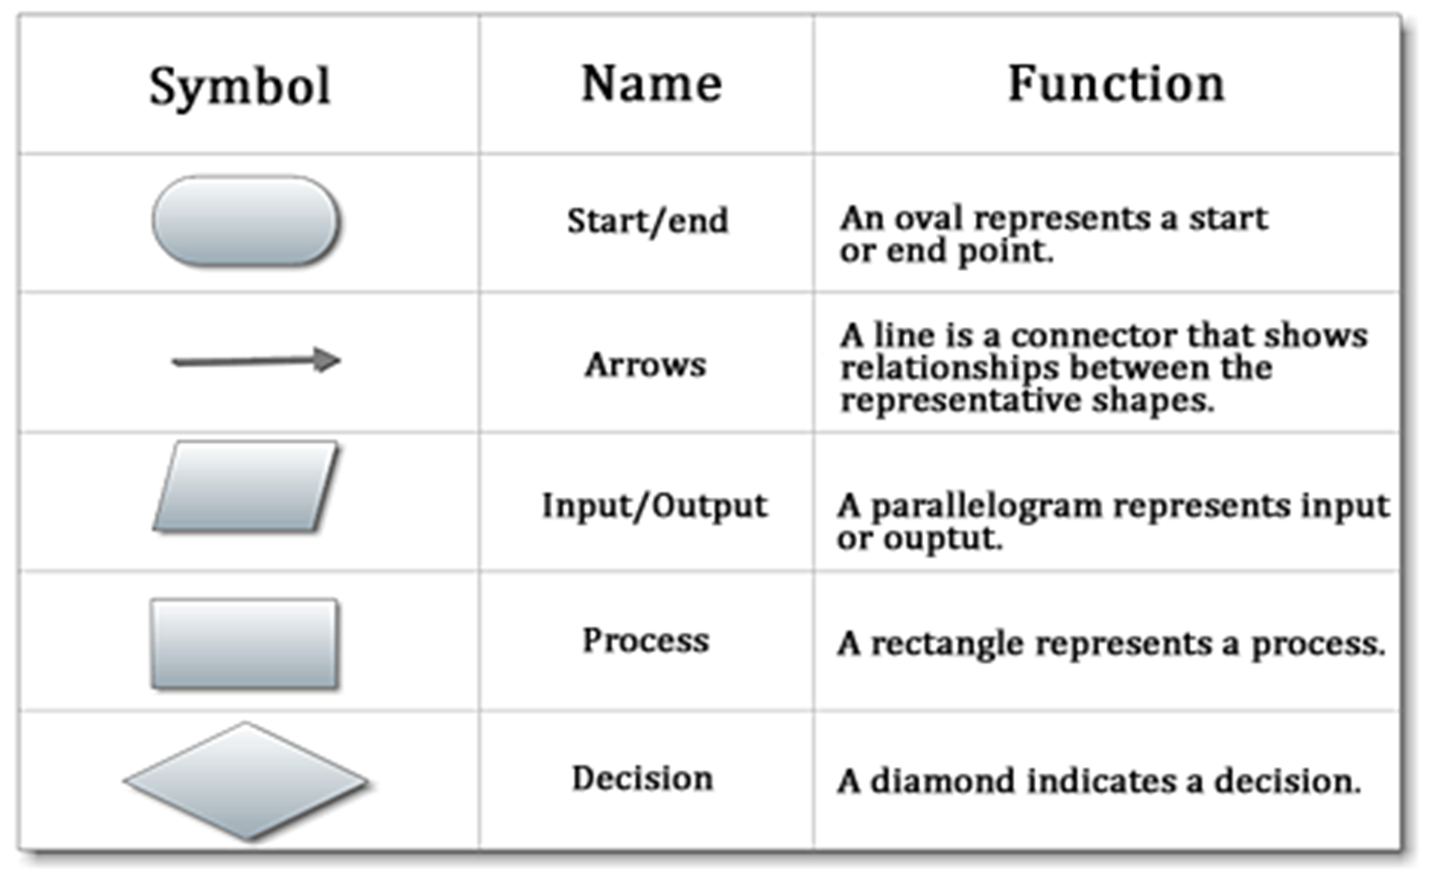
Flow chart

Slide 34
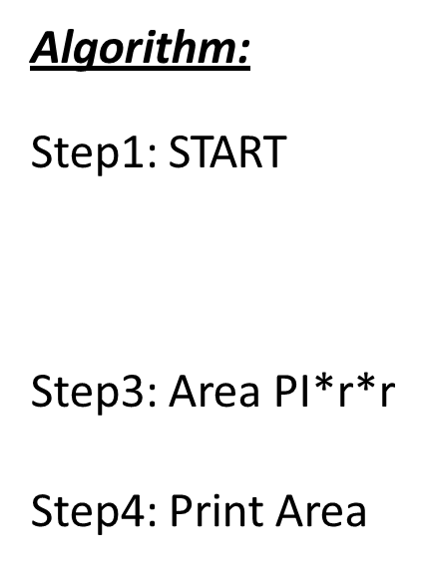
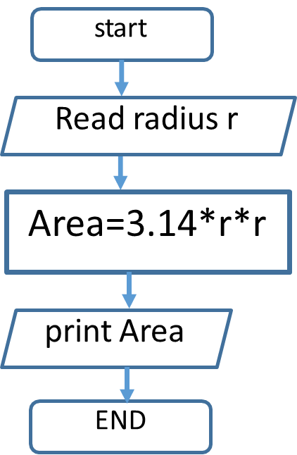
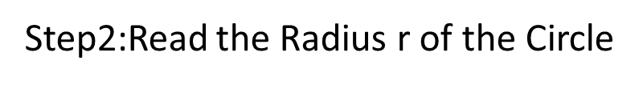
Flow chart
Flowchart for Finding area of a circle of radius r
Step5:END

Slide 35
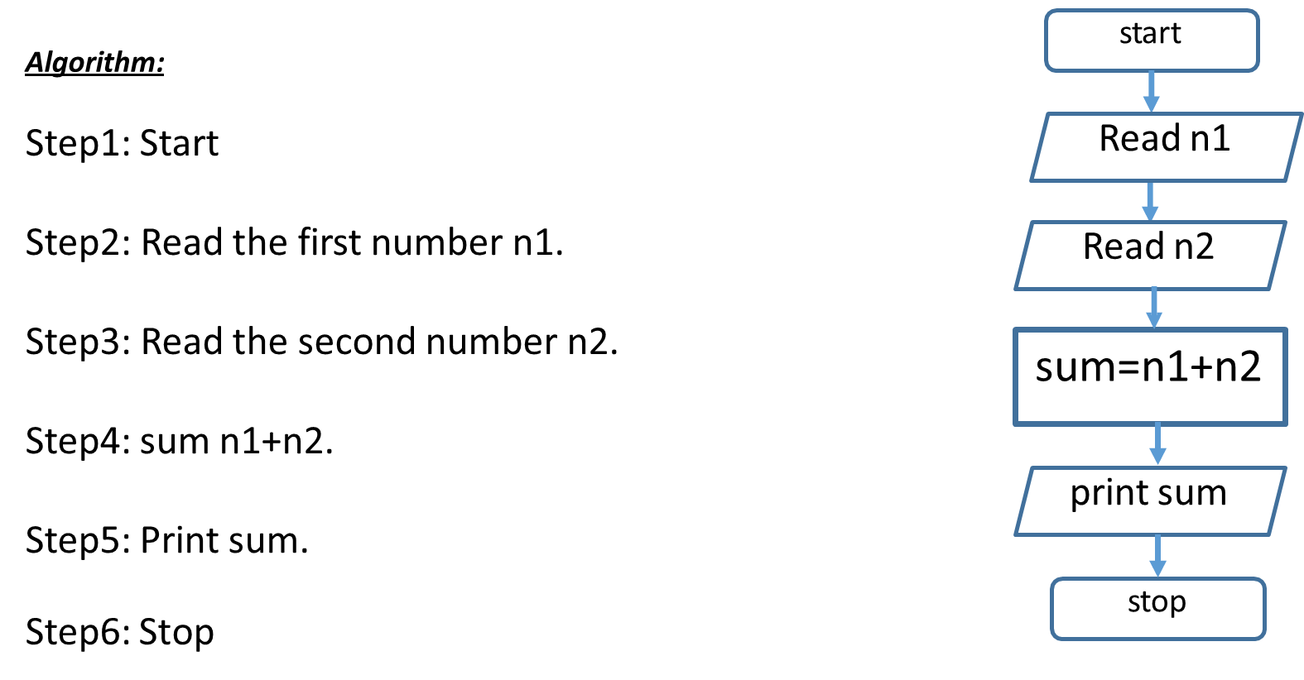
Flow chart
Flowchart to read two numbers and find their sum

Slide 36
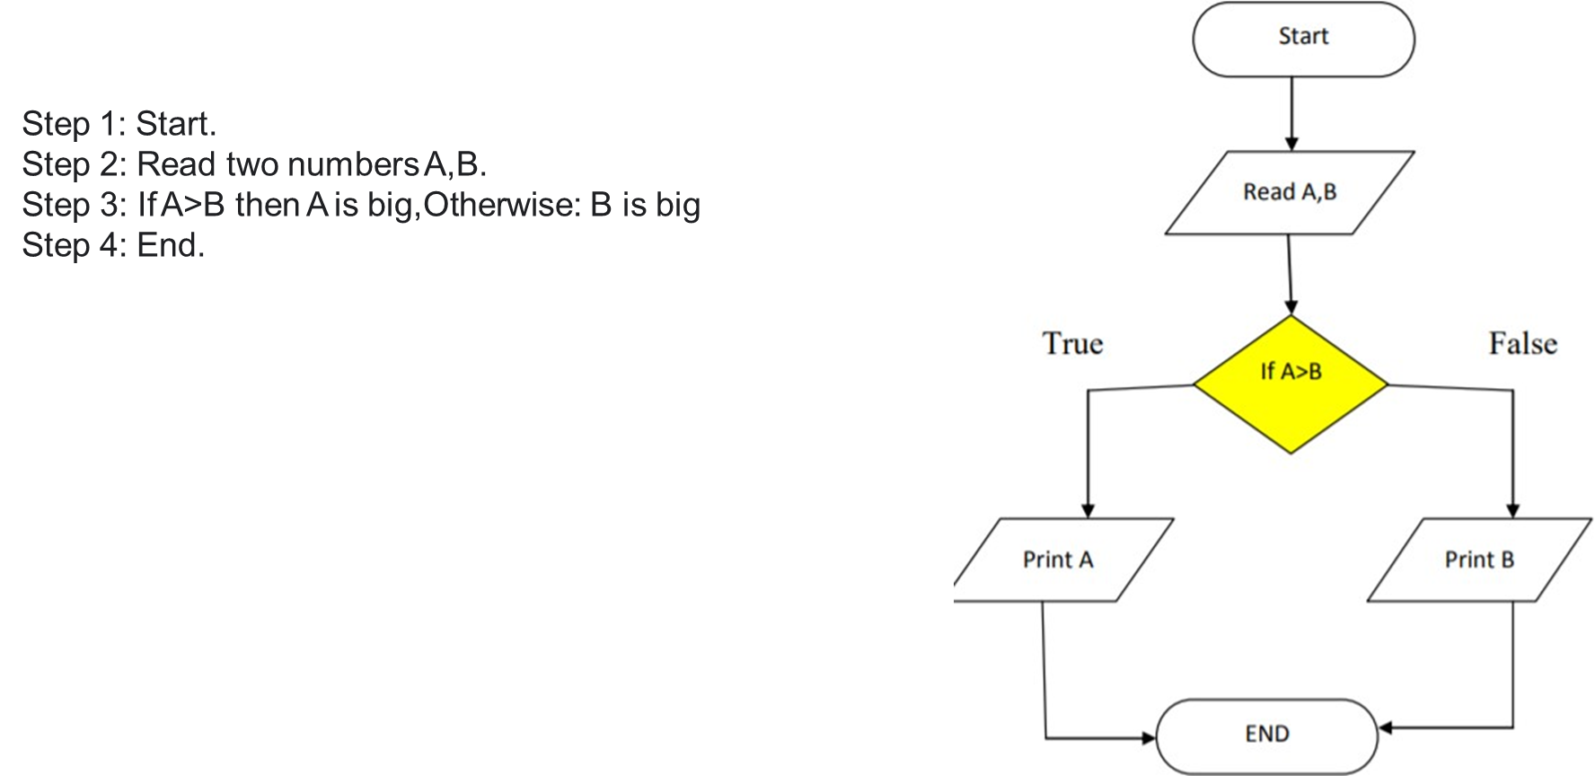
Flow chart
Algorithm, Flowchart to print the larger of two numbers

Slide 37
Pseudo code
Set of instructions that mimic programming language instructions.
Pseudocode is one of the tools that can be used to write a preliminary plan that can be developed into a computer program.
Pseudocode is a generic way of describing an algorithm without use of any specific programming language syntax.
It is, as the name suggests, pseudo code —it cannot be executed on a real computer

Slide 38
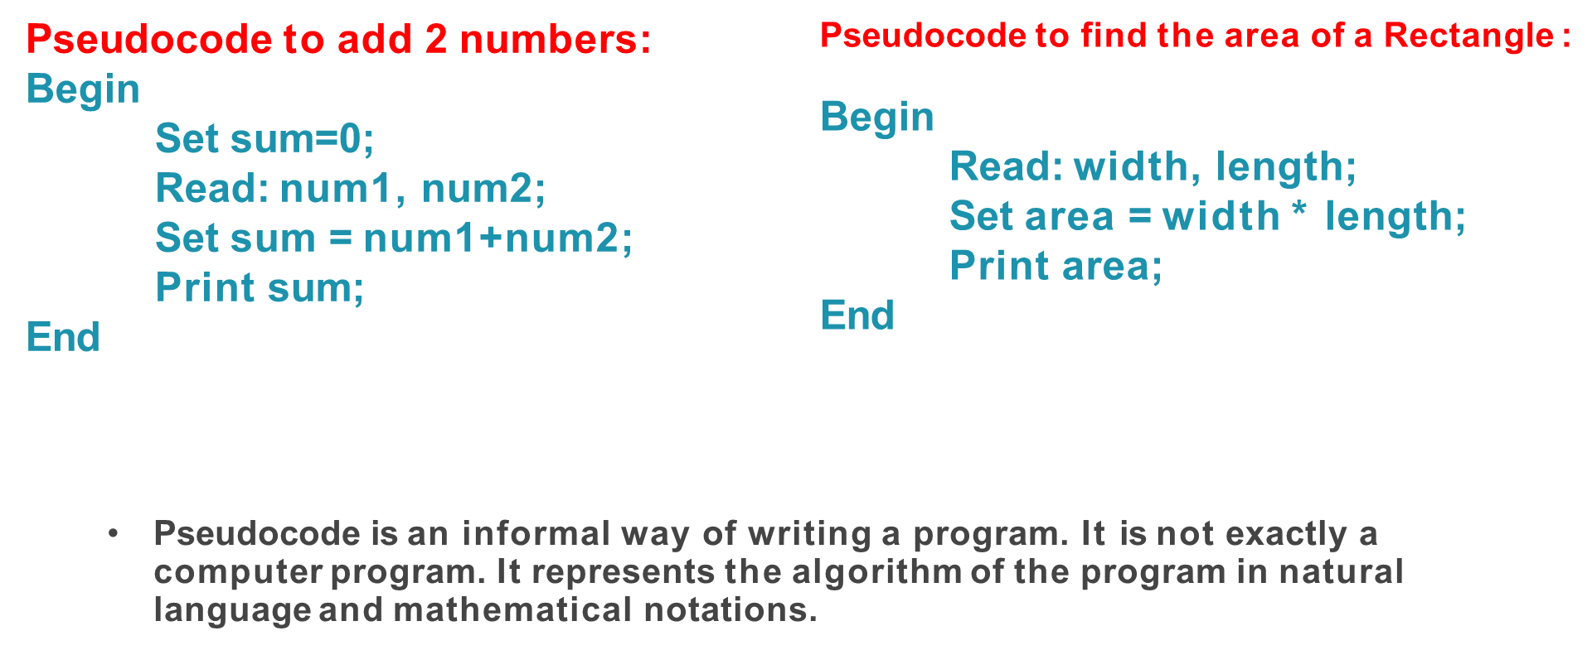
Pseudo code examples

Slide 39
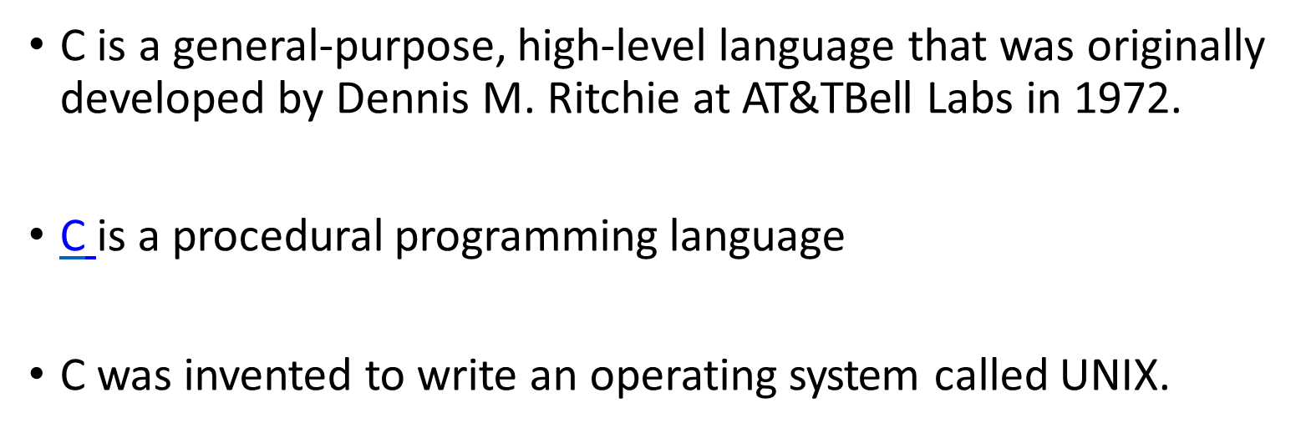
C language

Slide 40
History of C

Slide 41
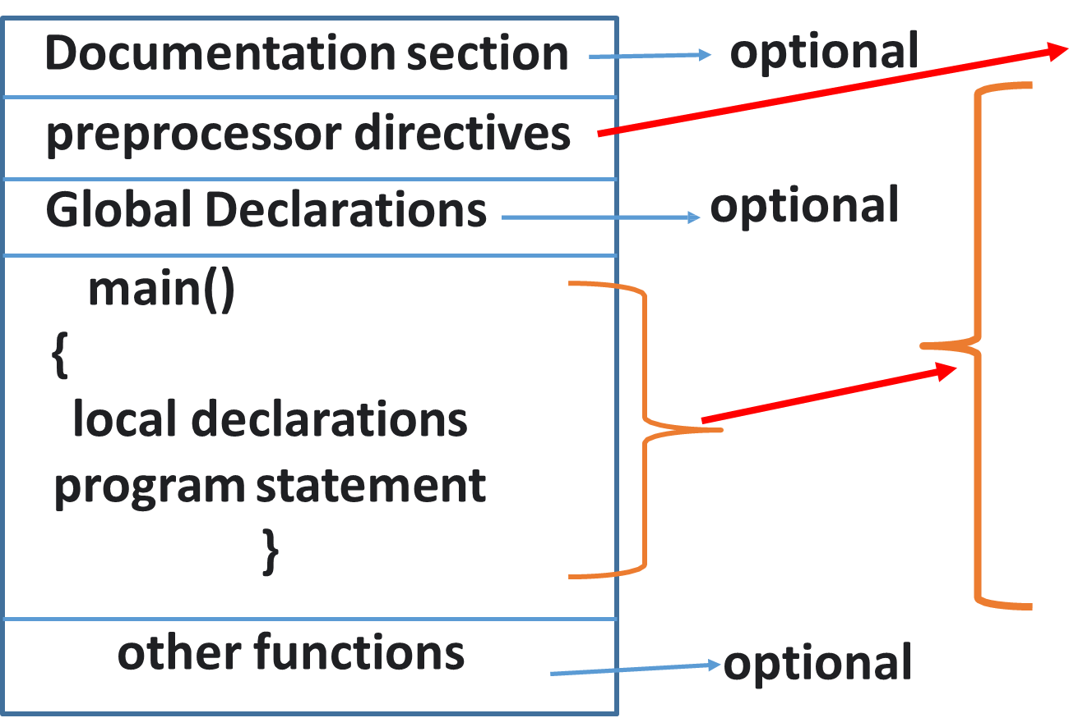
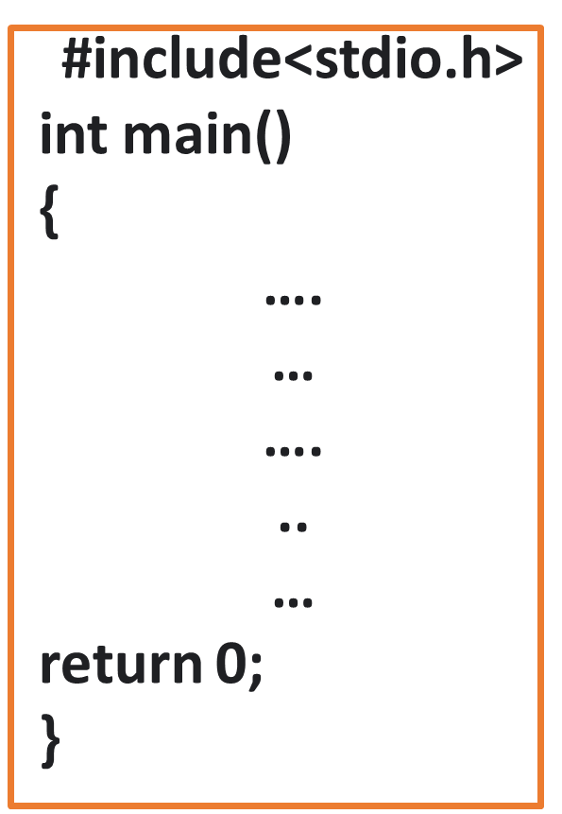
Structure of a c program

Slide 42
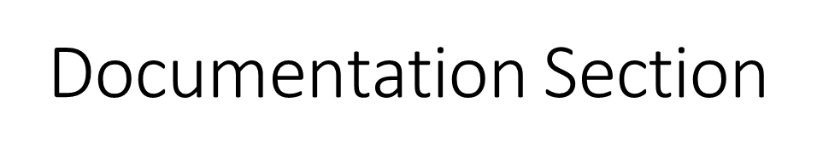
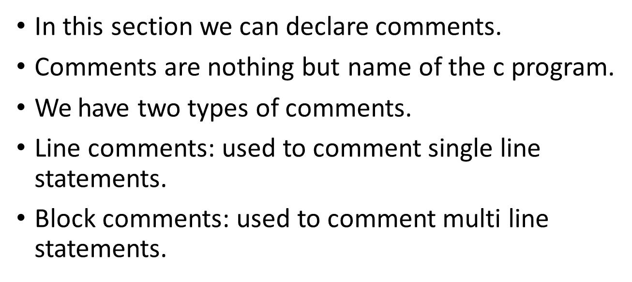
Structure of C Program

Slide 43
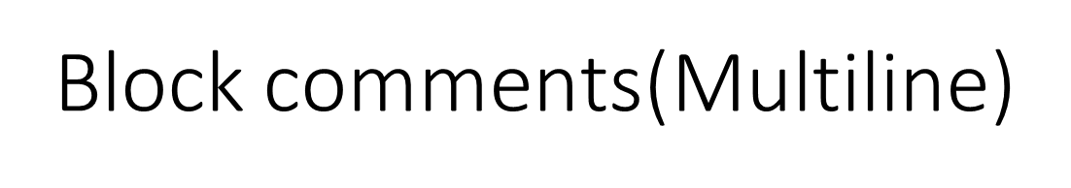
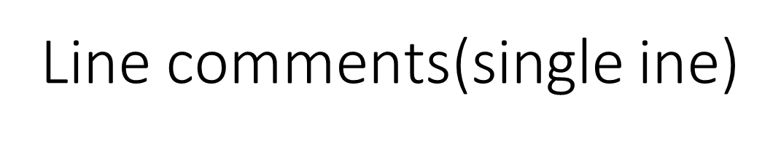
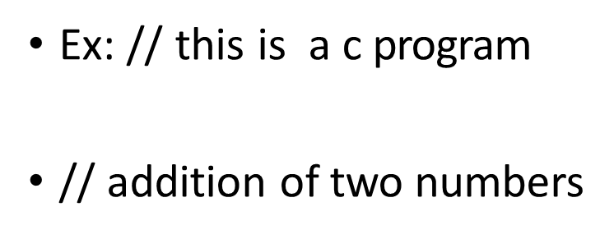
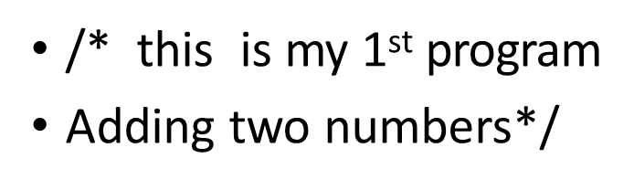
Structure of a c program

Slide 44

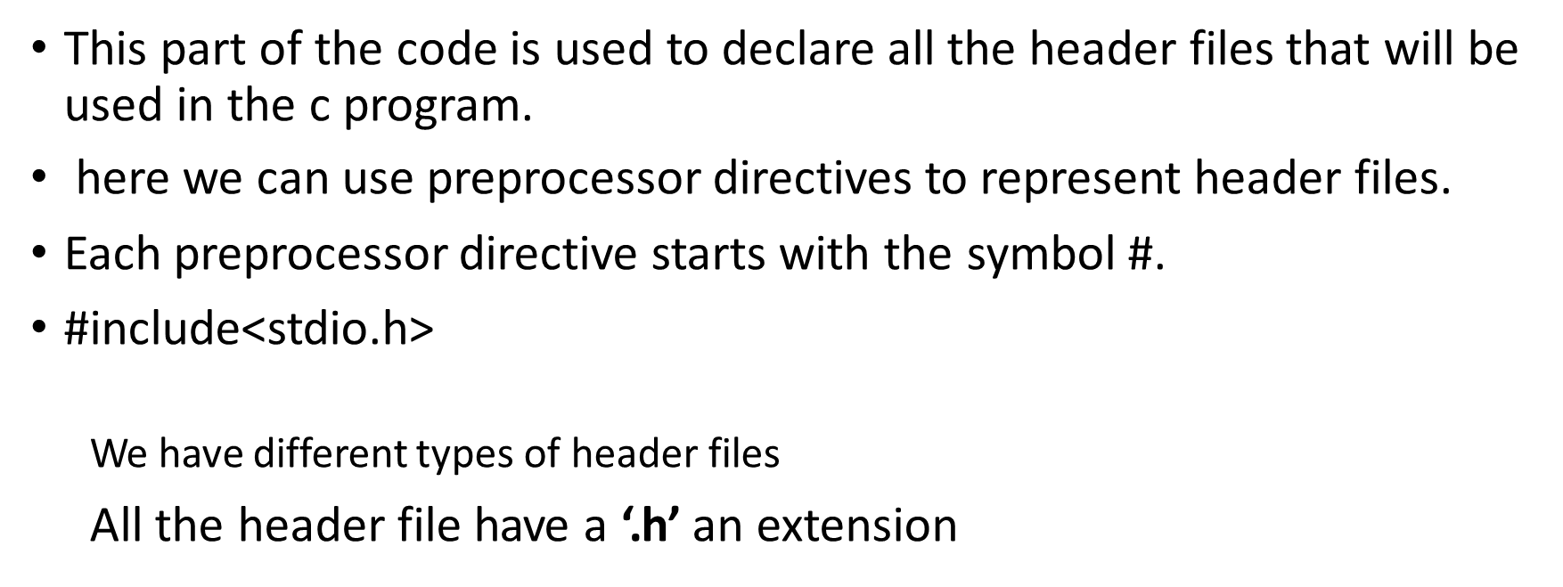
Structure of a c program

Slide 45
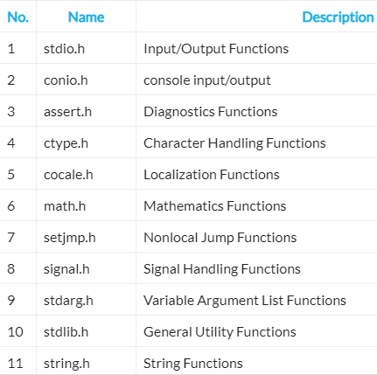

Slide 46
Global Declaration Section
All the global variable used are declared in this part. The user-defined functions are also declared in this part of the code.
int a=7;

Slide 47
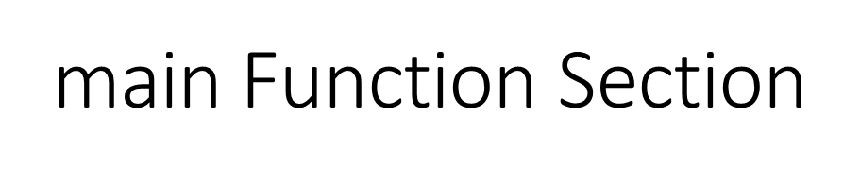
Every C-programs needs to have the main function.
Each main function contains 2 parts.
A declaration part and an Execution part.
The declaration part is the part where all the variables are declared.
The execution part begins with the curly brackets and ends with the curly close bracket.
Both the declaration and execution part are inside the curly braces.

Slide 48
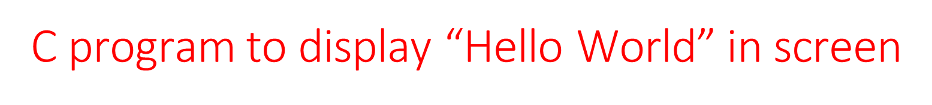
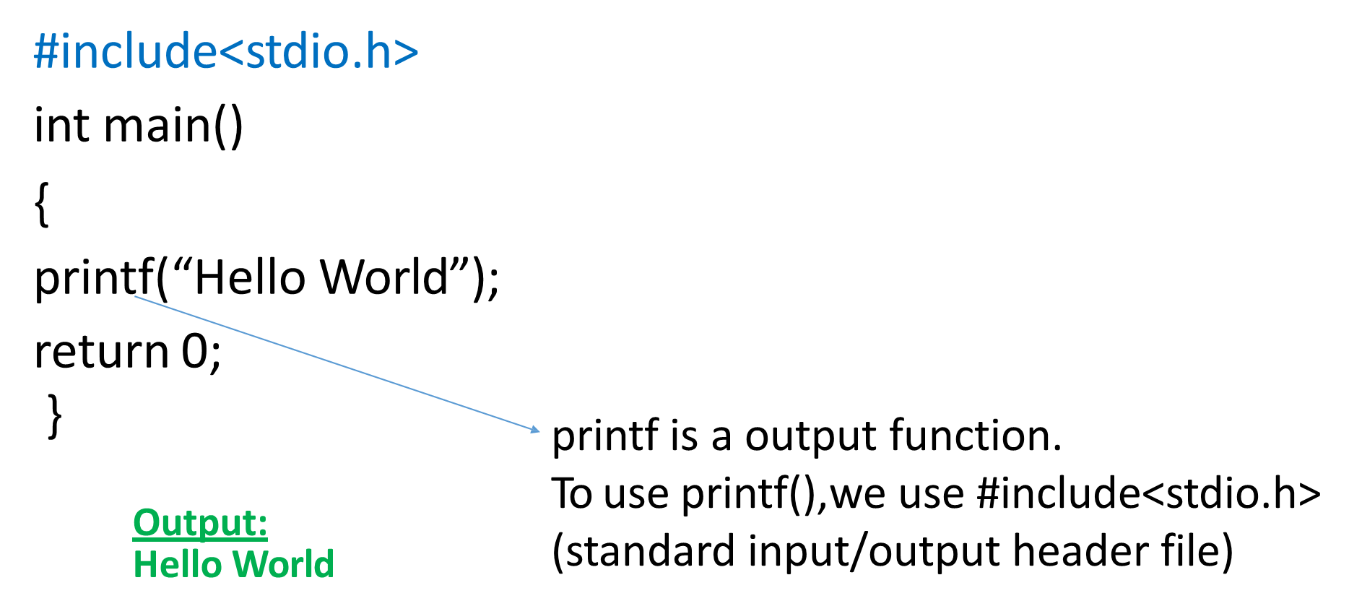


Slide 49
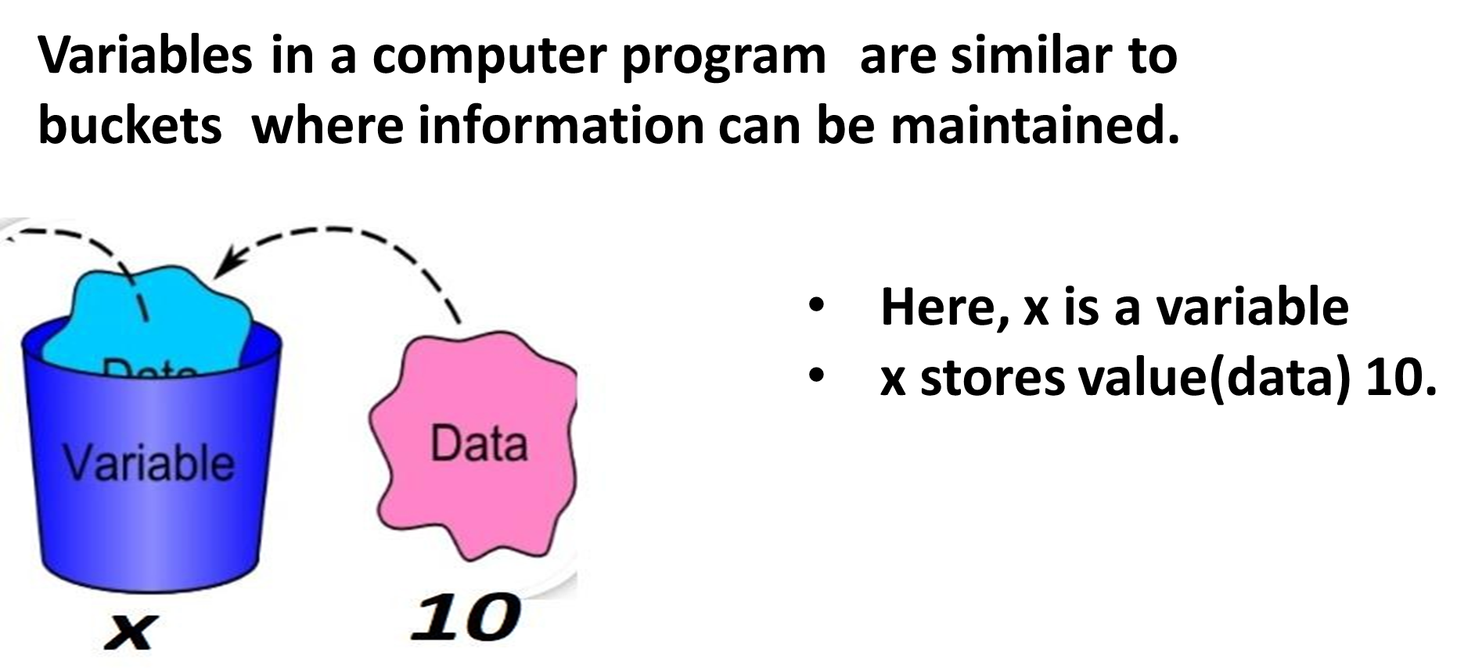
Variables

Slide 50
Variables
Variables are nothing but reserved memory locations to store values. when you create a variable you reserve some space in memory.
Based on the data type of a variable, the compiler allocates memory and decides what can be stored in the reserved memory. Therefore, by assigning different data types to variables, you can store integers, decimals or characters in these variables

Slide 51
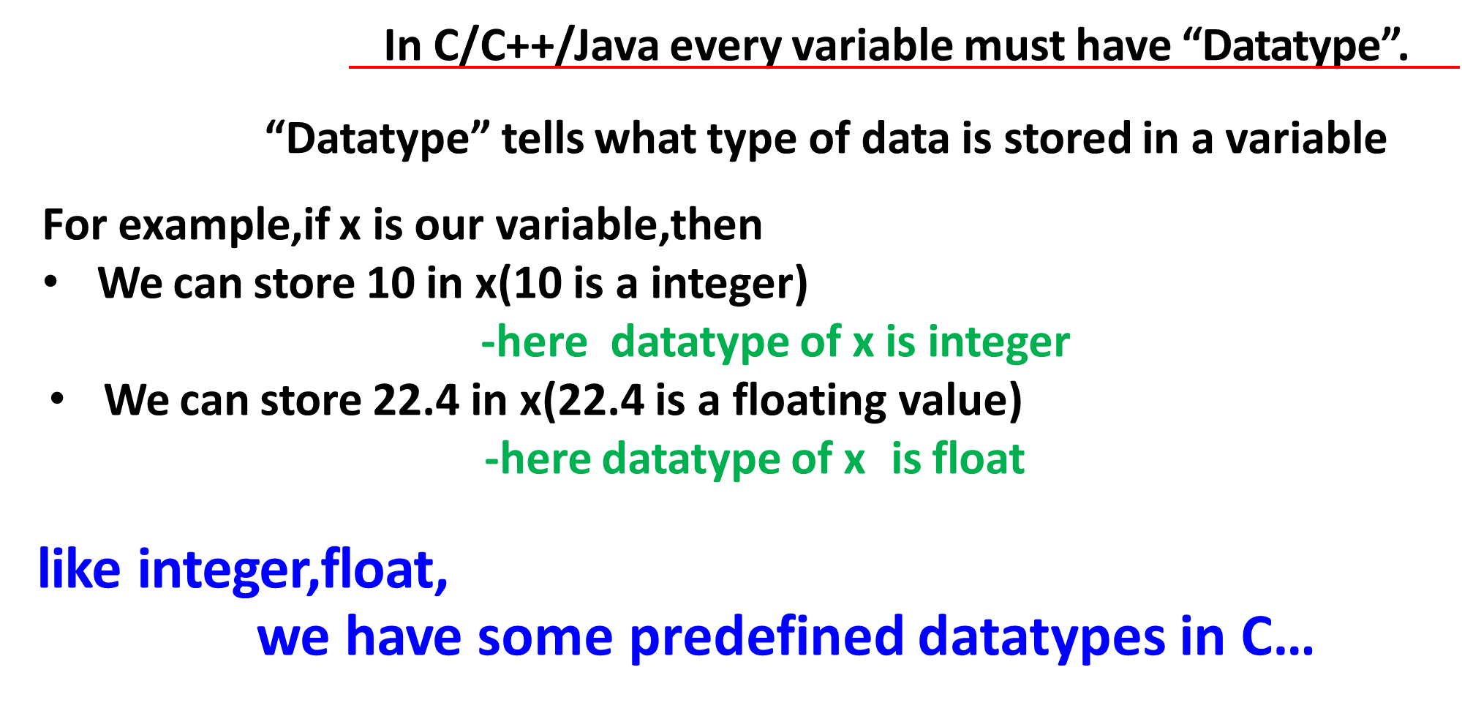
C Variables

Slide 52
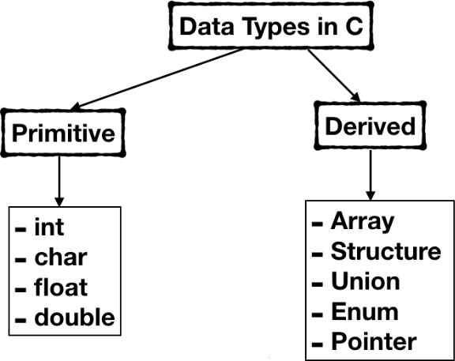
Datatypes
A data type specifies the type of data that a variable can store such as integer, floating, character, etc.

Slide 53
Basic Datatypes
Integer Data Type
The integer datatype in C is used to store the integer numbers(any number including positive, negative and zero without decimal part). Octal values, hexadecimal values, and decimal values can be stored in int data type in C.
Range: -2,147,483,648 to 2,147,483,647
Size: 4 bytes
Format Specifier: %d

Slide 54
Contd..
The integer data type can also be used as
unsigned int: Unsigned int data type in C is used to store the data values from zero to positive numbers but it can’t store negative values like signed int.
short int: It is lesser in size than the int by 2 bytes so can only store values from -32,768 to 32,767.
long int: Larger version of the int datatype so can store values greater than int.
unsigned short int: Similar in relationship with short int as unsigned int with int.

Slide 55
Character Data Type
Character data type allows its variable to store only a single character. The size of the character is 1 byte. It is the most basic data type in C.
Range: (-128 to 127) or (0 to 255)
Size: 1 byte
Format Specifier: %c

Slide 56
Float Data Type
In C programming float data type is used to store floating-point values. Float in C is used to store decimal and exponential values. It is used to store decimal numbers (numbers with floating point values) with single precision.
Range: 1.2E-38 to 3.4E+38
Size: 4 bytes
Format Specifier: %f

Slide 57
Double Data Type
The double data type is basically a precision sort of data type that is capable of holding 64 bits of decimal numbers or floating points.
Since double has more precision as compared to that float then it is much more obvious that it occupies twice the memory occupied by the floating-point type.
It can easily accommodate about 16 to 17 digits after or before a decimal point.
Range: 1.7E-308 to 1.7E+308
Size: 8 bytes
Format Specifier: %lf

Slide 58
Enumeration Data Type
A set of named constants or enumerators that represent a collection of connected values can be defined in C using the enumeration data type (enum).
Enumerations give you the means to give names that make sense to a group of integral values, which makes your code easier to read and maintain.
Ex:
enum DaysOfWeek {Monday, Tuesday, Wednesday, Thursday, Friday, Saturday, Sunday};
enum DaysOfWeek today;
today= Tuesday //that mean today=1

Slide 59
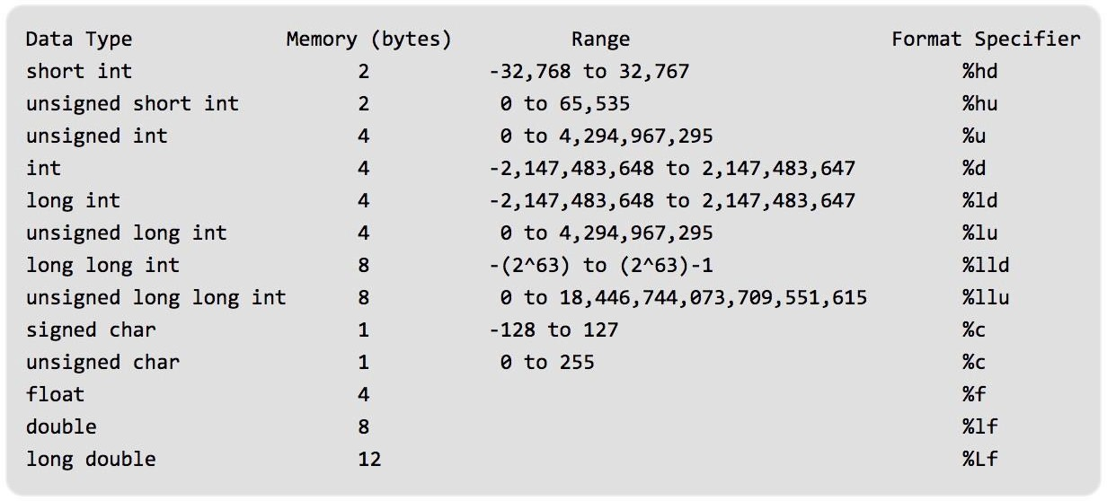
Datatypes

Slide 60
Now, how to declare variable with datatype?
This is called variable declaration
Syntax: datatype variablename;
Example:
int x; // x is declared as integer
float c; // c is declared as float
char g; // g is declared as character
For x, 4 bytes memory allocated(because size of int is 4 bytes) For c, 4 bytes memory allocated (because size of float is 4 bytes) For g, 1 byte memory allocated (because size of char is 1 byte)

Slide 61
Variables
C/C++/Java
So,In C/C++/Java every variable
must have “Datatype”.
x is declared as integer
int x; float y;
y is declared as float
Ok,but why variable names are x,y? How to assign variable names?

Slide 62
Identifiers
C identifiers represent the name in the C program, for example, variables, functions, arrays, structures, unions, labels, etc.
An identifier can be composed of letters such as uppercase, lowercase letters, underscore, digits, but the starting letter should be either an alphabet or an underscore.
Rules:
The first character of an identifier should be either an alphabet or an underscore, and then it can be followed by any of the character, digit, or underscore.
It should not begin with any numerical digit.
we can say that identifiers are case sensitive.
Commas or blank spaces cannot be specified within an identifier.
Keywords cannot be represented as an identifier.
The length of the identifiers should not be more than 31 characters.
Identifiers should be written in such a way that it is meaningful, short, and easy to read.
Example of valid identifiers
total, sum, average, _m _, sum_1, etc.

Slide 63
Keywords((Reserved words)
Keywords in C are reserved words that have predefined meanings and are part of the C language syntax.
These keywords cannot be used as variable names, function names, or any other identifiers within the program except for their intended purpose.
They are used to define the structure flow and behavior of a C program.
characteristics of C keywords:
Reserved: The C language reserves keywords are those keywords that cannot be used as identifiers in programs. Using a keyword as a variable name or other identifier will cause a compilation error.
Predefined Meaning: Each keyword has a specific meaning that is assigned by the C language. These meanings are built into the C language's grammar and syntax and the compiler interprets them accordingly.
Specific Use: Keywords are designed for specific purposes and contexts within the C language. They define control structures, data types, flow control, and other language constructs.

Slide 64
A list of 32 keywords in the c language is given below:
auto | break | case | char | const | continue | default | do
double | else | enum | extern | float | for | goto | if
int | long | register | return | short | signed | sizeof | static
struct | switch | typedef | union | unsigned | void | volatile | while

Slide 65
Assigning Values to Variables
After declaring a variable, we can assign a value to the variable as follows
syntax:
datatype variablename=value;
Example:
int x=10;
float y=23.4;
int x;
x=10;
or

Slide 66
Program to assign a value to variable and display it
printf() used in two different ways
Used to print text message(Type in double quotes)
Used to print value of a variable
syntax:
printf(“format specifier”,variablename);
Example: x=10;
printf(“%d”, x);
%d for int
%f for float
%c for char

Slide 67
Program to assign a value to variable and display it
#include<stdio.h>
main()
{
int x=10;
printf(“%d”, x);
}
Output: 10
here the value of x is taken as 10.(value assigned in the program)
We can also give x value from keyboard(as input after execution of program).

Slide 68
Reading variable values from keyboard(Input function)
To enter input from keyboard, a input function “scanf” is used.
syntax:
scanf(“format string”, &variablename);
#include<stdio.h>
main()
{
int x;
printf(“enter number”);
scanf(“%d”, &x);
printf(“\n%d”,x);
}
Output:
enter number 100
100

Slide 69
Program to print cube of given number
#include<stdio.h>
main(){
int number;
printf("enter a number:");
scanf("%d",&number);
printf("cube of number is:%d ",number*number*number);
}
Output:
enter a number:5
cube of number is:125

Slide 70

Constants
A constant is a value or variable that can't be changed in the program.
There are different types of constants in C programming.
Number system:
name digits base
binary | 0,1 | 2
decimal | 0 to 9 | 10
octal | 0 to 7 | 8
hexadecimal | 0 to 9, | 16
 | A,B,C,D, E,F
octal constant denoted with leading 0
hexadecimal constant by leading 0x or 0X
single character constant denoted in single quotes
String constant denoted with double quotes

Slide 71
Constants
There are two ways to define constant in C programming.
const keyword
#define preprocessor
C const keyword
The const keyword is used to define constant in C programming.
syntax:
const datatype variable=value;
Example program:
#include<stdio.h>
int main()
{
const float PI=3.14;
printf("The value of PI is: %f",PI);
return 0;
}
output:The value of PI is: 3.140000

Slide 72
Constants
2) C #define preprocessor
#define preprocessor directive is also used to define constant in C programming.
syntax:
#define variable value
Example:
#include<stdio.h>
#define PI 3.14
main()
{
printf("The value of PI is: %f", PI);
}
output: The value of PI is: 3.140000

Slide 73
Operators
An operator is simply a symbol that is used to perform operations.
Types of operators in c:
Arithmetic Operators
Assignment Operator
Relational Operators
Logical Operators
Bitwise Operators
Ternary or Conditional Operators
Special Operators

Slide 74
Arithmetic Operators
An arithmetic operator is a symbol that will perform some arithmetic operation.
SYMBOL | OPERATION | EXAMPLE | VALUE OF ans
+ | addition | ans = 7 + 3; | 10
- | subtraction | ans = 7 - 3; | 4
* | multiplication | ans = 7 * 3; | 21
/ | division | ans = 7 / 3; | 2
% | modulus | ans = 7 % 3; | 1

Slide 75
Arithmetic operators-example program
// Working of arithmetic operators #include <stdio.h>
int main()
{
int a = 9,b = 4, c; c = a+b;
printf("a*b = %d \n",c); c = a/b;
printf("a/b = %d \n",c); c = a%b;
printf(“a%b = %d \n",c);
return 0;
output: }
a+b = 13
a-b = 5
a*b = 36
a/b = 2
Remainder when a divided by b=1
printf("a+b = %d \n",c); c = a-b;
printf("a-b = %d \n",c); c = a*b;

Slide 76
Assignment Operators
Operator | Example | Equivalent
= | Assignment | i=10
+= | i += 8 | i = i + 8
-= | f -= 8.0 | f = f - 8.0
*= | i *= 8 | i = i * 8
/= | i /= 8 | i = i / 8
%= | i %= 8 | i = i % 8

Slide 77
Assignment operators-example program
#include<Stdio.h>
int main()
{
int a=5,c;
c=a; //c=5
printf("%d\n",c);
c+=a; //c=10
printf("%d\n",c);
c-=a; //c=5
printf("%d\n",c);
c*=a; //c=25
printf("%d\n",c);
c/=a; //c=5
printf("%d\n",c);
c%=a; //c=0
printf("%d\n",c);
return 0;
}

Slide 78
Relational Operators
Operator | Meaning of Operator | Example
== | Equal to | 5 == 3 is evaluated to 0
> | Greater than | 5 > 3 is evaluated to 1
< | Less than | 5 < 3 is evaluated to 0
!= | Not equal to | 5 != 3 is evaluated to 1
>= | Greater than or equal to | 5 >= 3 is evaluated to 1
<= | Less than or equal to | 5 <= 3 is evaluated to 0

Slide 79
Relational operators-example program
// Working of relational operators #include <stdio.h>
int main()
{
int a = 5, b = 5, c = 10;
printf("%d \n", a == b); printf("%d\n",a == c); printf("%d\n"a > b); printf("%d \n", a > c);
printf("%d \n", a < b);
printf("%d \n", a < c);
printf("%d\n", a != b);
printf("%d \n", a != c); printf("%d \n", a >= b); printf("%d \n“, a >= c); printf("%d \n", a <= b); printf("\n", a <= c);
return 0;
}

Slide 80
Logical Operators
Operator | Meaning | Example
&& | Logical AND. True only if all operands are true | If c = 5 and d = 2 then, expression ((c==5) && (d>5)) equals to 0.
|| | Logical OR. True only if either one operand is true | If c = 5 and d = 2 then, expression ((c==5) || (d>5)) equals to 1.
! | Logical NOT. True only if the operand is 0 | If c = 5 then, expression !(c==5) equals to 0.

Slide 81

Truth Tables

Slide 82
Example program
i/p1 | i/p2 | i/p1 && i/p2 | i/p1 || i/p2 | i/p1 ^ i/p2
0 | 0 | 0 | 0 | 0
0 | 1 | 0 | 1 | 1
1 | 1 | 1 | 1 | 0
1 | 0 | 0 | 1 | 1
#include<stdio.h>
int main()
{
int a=2,b=3,c=4;
printf("%d\n",(a<b&&b>c)); //1 && 0=0
printf("%d\n",(a<b||b>c)); //1||0=1
printf("%d\n",!(a<b&&b>c)); //!(1&&0)=!(0)=1
return 0;
}

Slide 83

Bitwise Operators

Slide 84




Example
11 & 5 =?
11 | 5 = ?

Slide 85
Bitwise operators-example
~ operation:
a=6 0110
Filp bits 1001→(1)
-7 in 2’s complement form
#include <stdio.h> int main()
{
int a=6; int b=5;
printf("%d",a|b);
printf("%d",a&b);
printf("%d",a^b);
printf("%d",~a);
printf("%d",a<<2);
printf("%d",a>>2); return 0;}
a=6 0000 0110
b=5 0000 0101
……………………………….
7
Flip bits
Add 1
0111
1000
1001 →(2)
a|b 0000 0111=7
a&b 0000 0100=4
a^b 0000 0011=3
(1),(2) are same (or)
~a=-(a+1)
~6=-(6+1)=-7
7
4
3
-7
24
<< operation:
a=6 0000 0110
a<<1 0000 1100
a<<2 0001 1000 → 24
1
>> operation:
a=6 0000 0110
a>>1 0000 0011
a>>2 0000 0001 → 1

Slide 86

Conditional /Ternary Operator(?:)
Ternary operator is a shorthand version of if-else statement. It has three operands and hence the name ternary.
syntax: booleanExpression? expression1: expression2
#include <stdio.h>
int main()
{
int a,b,c; // variable declaration
printf(“enter two numbers”);
scanf("%d%d",&a,&b);
c=((a>b)?(a):(b)); // conditional operator
printf(“\n big number is : %d", c);
return 0;
}

Slide 87
Biggest of 3 numbers using Conditional Operator
#include <stdio.h> int main()
{
int a,b,c,max; // variable declaration
printf(“enter 3 numbers”);
scanf(" %d%d%d",&a,&b,&c);
max=a>b?(a>c?a:c):(b>c?b:c); // nesting of conditional operator printf(“\nbig number is : %d",max);
return 0;
}

Slide 88
Increment /Decrement Operators(Unary Operators)
Unary operators are used to increment, decrement or negate a value.
Unary minus(-): used for negating the values.
Example: int a= -20;
Unary plus(+):used for giving positive values. Only used when deliberately converting a negative value to positive.
++ :Increment operator, used for incrementing the value by 1.
There are two varieties of increment operator.
Post-Increment :Value is first used for computing the result and then incremented.
Pre-Increment : Value is incremented first and then result is computed.
- - : Decrement operator, used for decrementing the value by 1.
There are two varieties of decrement operator.
Post-Decrement : Value is first used for computing the result and then decremented.
Pre-Decrement : Value is decremented first and then result is computed.

Slide 89

Increment/Decrement Operators example
int a=10; a++;
print(a)
int a=10;
++a;
print(a)
11
11
preincrement: First increment later assignment
postincrement: First assignment later increment
int a=10; int b; b=++a; print(a) print(b)
int a=10; int b; b=a++;
11
11
11
10

Slide 90
Special Operators
Operator | Description | Example
sizeof() | Returns the size of a variable. | sizeof(a), where a is integer, will return 4.
& | Returns the address of a variable. | &a; returns the actual address of the variable.
* | Pointer to a variable. | *a;

Slide 91
Example:
#include<stdio.h>
int main()
{
int x=50; // variable declaration.
printf("size of the variable x is %d", sizeof(x));
// Displaying the size of ?x? variable.
printf("\nsize of the integer data type is %d",sizeof(int));
//Displaying the size of integer data type.
printf("\nsize of the character data type is %d",sizeof(char));
//Displaying the size of character data type.
printf("\nsize of the floating data type is %d\n",sizeof(float));
//Displaying the size of floating data type.
printf("the address of x is %d\n",&x);
return 0;
}
Output:
size of the variable x is 4
size of the integer data type is 4
size of the character data type is 1
size of the floating data type is 4
the address of x is 6487580

Slide 92
Operators Precedence in C
Operator precedence determines the grouping of terms in an expression and decides how an expression is evaluated.
It specifies which operators are evaluated first and which are evaluated last when multiple operators are present in an expression
Certain operators have higher precedence than others.
For example, the multiplication operator has a higher precedence than the addition operator.

Slide 93
The following is a list of operators in C sorted by precedence, from highest to lowest:
Parentheses () - Expressions enclosed in parentheses are evaluated first.
Postfix increment/decrement (++/--): These operators increase or decrease the value of a variable by 1 after the expression is evaluated.
Prefix increment/decrement (++/--): These operators increase or decrease the value of a variable by 1 before the expression is evaluated.
Unary plus/minus (+/-): These operators are used to specify the sign of a value.
Logical negation (!): The logical negation (!) operator is used to make a boolean expression's logical meaning the opposite.
Bitwise complement (~): This operator is used to flip the bits of a value.
Casts: These operators are employed to change an expression's type into another type.
Multiplication/division/modulo (* / %): These operators perform multiplication, division, and modulo operations.
Addition/subtraction (+ -): These operators perform addition and subtraction operations.
Bitwise shift (<< >>): These operators are employed to left- or right-shift the bits of a number.

Slide 94
Relational operators (< <= > >=): These operators perform a comparison between two numbers and provide a boolean result as a result.
The equality operators (==!=): These operators compare two values to see if they are equal and then deliver a boolean result based on the comparison
Bitwise AND (&): This operator combines two numbers in a bitwise manner.
Bitwise XOR (): Using this operator, two numbers are bitwise XORed.
Bitwise OR (|): This operator combines two numbers in a bitwise manner.
Logical AND (&&): The logical AND operator (&&) applies the logical AND function to two boolean values.
Logical OR (||): Using this operator, two boolean numbers are logically combined. Ternary conditional operator (?:): This operator allows for a conditional statement that is used to evaluate one of two expressions based on the result of a boolean expression.
Assignment (= += -= *= /= %= <<= >>= &= ^= |=): These operators are used to assign a value to a variable, or to modify the value of a variable.

Slide 95
Operators Precedence & Associativity in C
Category | Operator | Associativity
Postfix | () [] -> . ++ - - | Left to right
Unary | + - ! ~ ++ - - (type)* & sizeof | Right to left
Multiplicative | * / % | Left to right
Additive | + - | Left to right
Shift | << >> | Left to right
Relational | < <= > >= | Left to right
Equality | == != | Left to right
Bitwise AND | & | Left to right
Bitwise XOR | ^ | Left to right
Bitwise OR | | | Left to right
Logical AND | && | Left to right
Logical OR | || | Left to right
Conditional | ?: | Right to left
Assignment | = += -= *= /= %=>>= <<= &= ^= |= | Right to left
Comma | , | Left to right

Slide 96

Precedence rules and Associativity: Example
=10+10-1*4
In +,-,*
*(Multiply) has high precedence,so apply multiplication(*).
Consider variable values as follows a=10
b=20
c=2 d=1 e=4
What is the value of a+b/c-d*e?
=10+10-4
1)+ and- have equal precdedence,so apply associativity.
2) + is left most,so apply +
=20-4
=16
Sol)a+b/c-d*e
=10+20/2-1*4
1)/ and * has more precedence than + and –. 2)But / and * has equal precedence,so apply associativity(left to right).
3)Leftmost in / and * is /.So apply division(/)

Slide 97
Type Conversion
Type conversion, is a method of convert one data type into another
The procedure of changing a variable's data type is known as type casting
Syntax:
(type)value;
Without Type Casting:
int f= 9/4;
printf("f: %d\n", f) ;//Output: 2
With Type Casting:
float f=(float) 9/4;
printf("f: %f\n", f) ;//Output: 2.250000

Slide 98
Types of Type Casting
1)Implicit Type Conversion( i. promotion ii. Demotion)
2)Explicit Type Conversion(Type Casting)
Implicit Casting:
When the compiler automatically transforms the data from one type to another, it is referred to as implicit casting or automated type conversion.
#include <stdio.h>
int main() {
int num1 = 10;
float num2 = 5.5;
float result;
result = num1 + num2; // Implicit cast from int to float
printf("The result is: %f\n", result);
return 0;
}
In the example above, the integer value num1 is added to the float variable num2 after being implicitly cast to a float. The result variable contains a float value representing the outcome.
The result is: 15.500000

Slide 99

Promotion(small size to big size type)
Promotion does not create any problems. The rank of right expression is promoted to the rank of left expression. The value of the expression is the value of the right expression after the promotion.
bool -> char -> short int -> int -> unsigned int -> long -> unsigned -> long long -> float -> double -> long double
Demotion (Big size to small size type)
Demotion may or may not create problems. If the size of the variable of the left expression can accommodate the value of the expression, no problem arises but the results can be a bit different from those expected.
Ex: int -> short int-> char
promotion
Demotion

Slide 100








PROGRAMMING FOR PROBLEM SOLVING USING C
A.Lakshmanarao

Slide 101
Examples(implicit conversion)
Promotion always successful
Demotion may or may not successful
Promotion:Ex1 #include <stdio.h> int main()
{
int x=10; float y;
y=x; // int to float printf("%f",y);
return 0;
} // successful
Promotion:Ex2
#include <stdio.h>
int main()
{
int i;
char c='A';
i=c; // char to int printf("%d",i);
return 0;
} // successful
Demotion #include <stdio.h> int main()
{
Demotion #include <stdio.h> int main()
{
int i=650;
int i=65;
char c;
char c;
c=i; // int to char
c=i; // int to char
printf("%c",c);
printf("%c",c);
return 0;
} // not successful
return 0;
} // successful

Slide 102

This process is also called type casting and it is user defined. Here the user can type cast the result to make it of a particular data type.
The syntax in C:
(type) expression

Slide 103
Example-type casting
Example-1
Example-2
#include<stdio.h> int main()
{
double x = 1.2;
//Explicit conversion from double to int
int sum = (int)x + 1;
printf("sum = %d", sum);
return 0;
}
#include <stdio.h> int main()
{
float a=10.5,b=10.5;
int c;
c=(int)a+b;
// conversion from float to int printf("%d",c);
return 0;
}

